Slide 1
Decision Tree

Slide 2
Problem statement
Study the decision tree algorithm, focusing on both entropy based information gain and Gini index for splitting. Build decision trees and random forests for the loan datasets. As always, prepare three slides detailing problem description, data, technical approach, and results.

Slide 3
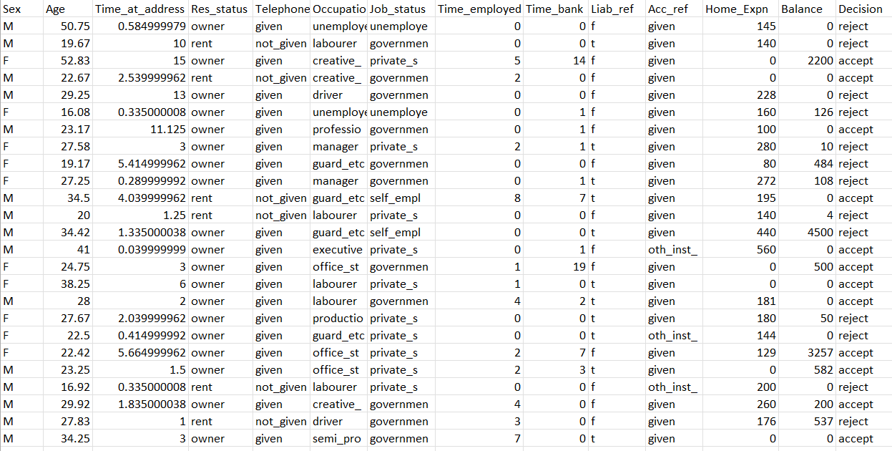
Loan Data

Slide 4
About Data
The loan dataset contains information about loan applicants
(['Sex', 'Age', 'Time_at_address', 'Res_status', 'Telephone', 'Occupation', 'Job_status', 'Time_employed', 'Time_bank', 'Liab_ref', 'Acc_ref', 'Home_Expn', 'Balance', 'Decision’}
The target variable is the outcome of the loan application, such as whether the loan was accepted or rejected.
The data will be pre-processed to handle any missing values or outliers.
Performing one hot encoding for the categorical columns to get respective continuous values as scikit learn's Decision Tree model doesn't permit categorical values

Slide 5
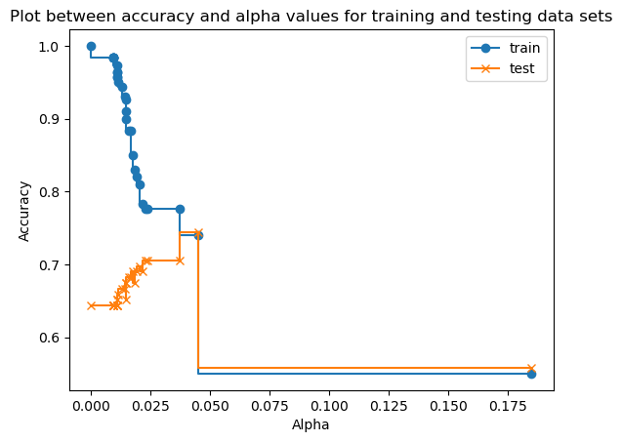
Building decision trees using Entropy-based Information Gain and Gini Index for splitting.
The decision tree before pruning was too big.
The alpha value can help us in getting a smaller tree for which we can make more sense and the accuracy can be better.
We got an accuracy score of 74% for the alpha value:- 0.05568812

Slide 6
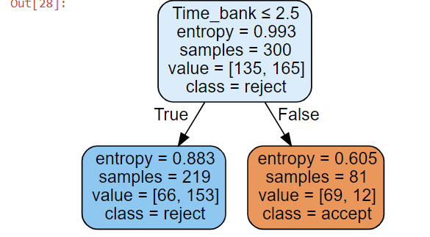

Slide 7
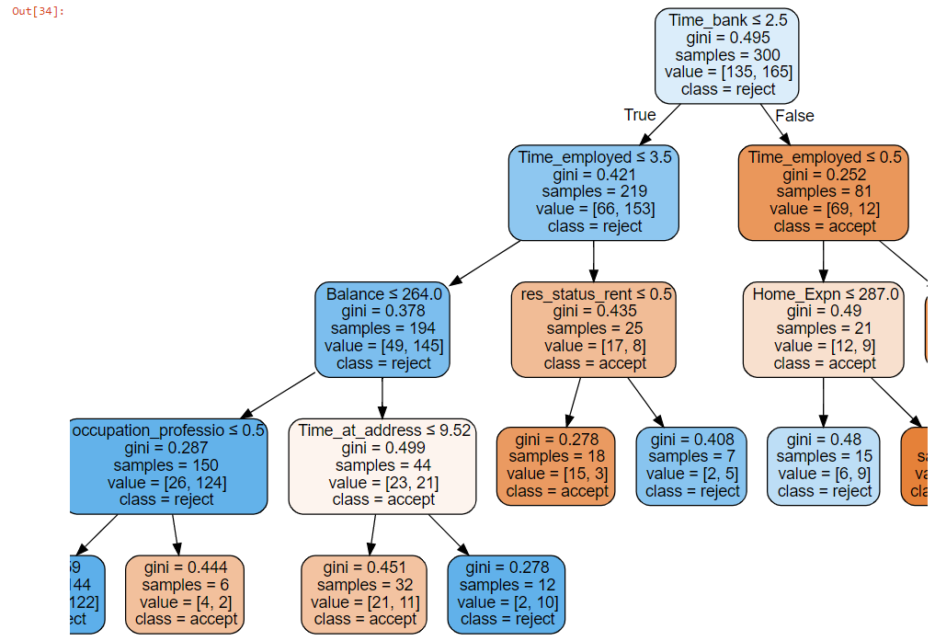
Gini criterion for the split.
We got an accuracy of about 72%

Slide 8
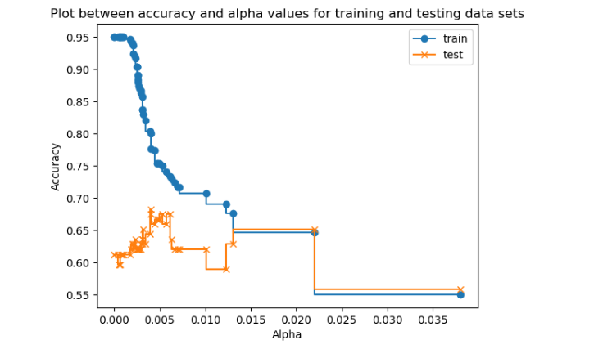
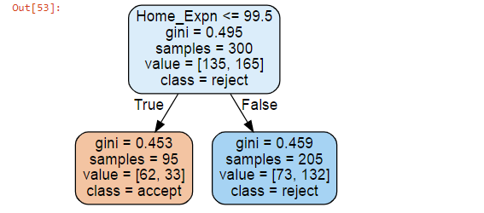
Random Forest
Random Forest is a type of machine learning algorithm that uses multiple decision trees to make predictions.
Each decision tree is trained on a randomly selected subset of the data and features.
The predictions from all decision trees are combined to make a final prediction.
This combination helps to reduce overfitting and improve the accuracy of the model.
Each decision tree is trained on a randomly selected subset of the data and features.
The predictions from all decision trees are combined to make a final prediction.
This combination helps to reduce overfitting and improve the accuracy of the model.

